Slide 1

Candidate Exam Guidance

Slide 2
Purpose of this Presentation
To inform candidates about the use of their personal data and copyright
To ensure candidates are provided with all relevant information about their exams in advance of any exams being taken
To ensure copies of relevant JCQ information for candidates documents and exam room posters are provided in advance of any exams/assessments being taken
To inform candidates about malpractice in examinations/assessments
To answer questions candidates may have
To inform candidates of/signpost candidates to any exams-related policies/procedures that they need to be made aware of

Slide 3
Personal Data & Copyright
To understand what information is collected and how it is used, you must read the JCQ Information for candidates - Privacy Notice (Distributed at Academic Mentoring)
The copyright of any work created by a candidate that is submitted to an awarding body for assessment (referred to as Assessment Materials) belongs to the candidate
By submitting this work, a candidate is granting the awarding body a non-exclusive, royalty-free licence to use their assessment materials (referred to as Assessment Licence)
If a candidate wishes to terminate the awarding body’s rights for anything other than assessing his/her work, the awarding body must be notified by the centre and it is at the discretion of the awarding body whether or not to terminate such rights

Slide 4
Individual Candidate Timetable
You should have received a Paper copy with room allocations
Take a photo of it on your phone, and add the dates in to your electronic calendar
You may not be seated in the same room/seat for all your exams so check notice board beside gym for seating plan

Slide 5
Equipment
A Clear Wallet will be provided for you with all the stationery for your Exams
It will contain:
BLACK Biro x2 (the only colour accepted by the exam boards)
Pencil x2
Eraser
Protractor
Ruler
Calculator (if allowed)
Highlighters – for use on the Question Paper only
If needed you can ask for a Pencil Sharpener, Tracing Paper & Compass

Slide 6
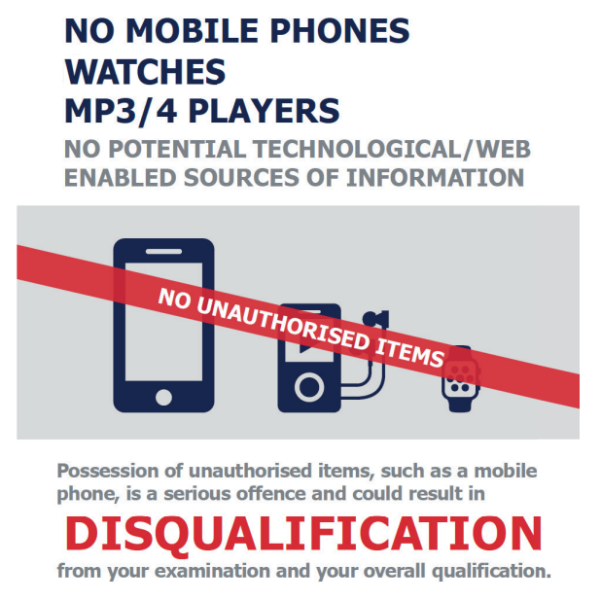
NEW for 2021-2022 – No watches are allowed in the examination room.
If you are found to be in possession of an unauthorised device during your exam, whether switched on or off, you are committing Malpractice and could result in you being disqualified.
All unauthorised materials will be collected by the Lead Invigilator before you enter the Exam Room

Slide 7
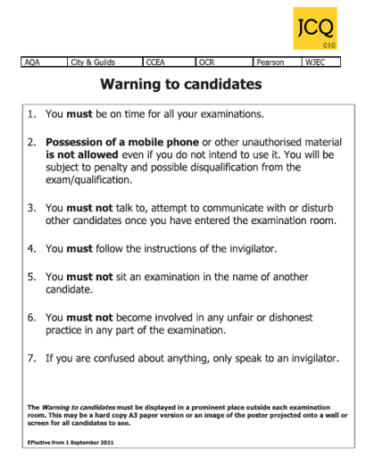
This poster will be displayed outside your exam room
You MUST note all the warnings

Slide 8
JCQ Information for Candidates
Video: Instructions for Candidates

Slide 9
Exam Timings
Morning exams begin at 9.00am
Afternoon exams begin at 1.15pm
Arrive on time or you may not be allowed to do your exam
The duration of exam papers vary, from 35min to 2hrs
If you have been awarded Extra Time you will be given the adjusted finish time
You MUST remain in the Exam Room for the whole exam

Slide 10
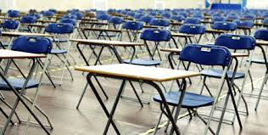
Seating
Once you have entered the exam room you are under exam conditions
This means that you cannot communicate in any way with any other Candidate
You will be directed to your room & seat by the Lead Invigilator
A candidate card will be on each exam desk
Do not deface or destroy the candidate cards
Once seated, the invigilator will read the instructions of the exam and will announce when you can start.
If possible leave your bag outside the room or at the front.
Do not write anything on your paper
until you are instructed to do so.
It is considered Malpractice if you do.
Disturbing the exam room in any way could get you disqualified

Slide 11
Invigilators
There to ensure the exams are run according to the regulations
Please listen to them and follow instructions
If you need any assistance, then please raise your hand high to alert an invigilator
You must not shout out
You cannot communicate with any students in the exam room
They are unable to answer any questions relating to the content of the exam paper
Video: Invigilators Announcement to Candidates

Slide 12
Malpractice
To maintain the integrity of qualifications, strict Regulations are in place
Malpractice means any action or behaviour which is in breach of the Regulations
Any alleged, suspected or actual incidents of malpractice will be investigated and reported to the relevant awarding body/bodies
The Joint Council for Qualifications (JCQ) provides information regarding what constitutes malpractice:
Introduction of unauthorised material into the examination room
Breaches of examination conditions
Exchanging, obtaining, receiving, or passing on information which could be examination related (or the attempt to)
Offences relating to the content of candidates’ work
Undermining the integrity of examinations/assessments

Slide 13
Malpractice
You need to know that the following would be malpractice:
copying or allowing work to be copied
e.g. posting written work on social networking sites prior to an examination/assessment;
collusion: allowing others to help produce your work or helping others with theirs;
asking others about what questions your exam will include (even if no one tells you);
having or sharing details about exam questions before the exam
whether you think these are real or fake
not telling exam boards or your school/college about exam information being shared.

Slide 14
Malpractice
There are severe penalties for malpractice.
You could be disqualified from your exams.
Examples of malpractice:
Possession of a mobile phone or smart enabled device - even if switched off
Writing/drawing obscene material
Talking/disrupting others
Possession of notes
Writing on hands/skins
Possession of a Watch
Offensive Language
Please check your pockets before you go into every exam

Slide 15
Consequences of Malpractice
If you are caught or suspected of committing malpractice, then an investigation will take place, we are obliged to report it to the Exam Boards and they will make the decision on sanction.
Written warning
Loss of marks for that paper
Loss of marks for that subject
Loss of marks for all exams with the that exam board
All exams cancelled for all exam boards
Banned from taking exams for 1-5 years
4,895 cases of malpractice involving students were proven and penalised in 2023.
44.5% of those were due to mobile phones

Slide 16
Unauthorised Items
The following are not allowed in the exam room:
Mobile phones, other smart enabled device, watches
Non transparent water bottles/pencil cases
Gel Pens
Tippex
Earphones/plugs
Food
Writing on hands/skin
Labels on water bottles
Notes of any sort - check your pockets
Watches

Slide 17
If you are ill on the day of an exam
If you are feeling unwell on the day of your exam, we suggest you come into school and we can assess the situation when you arrive.
In most cases, it is better to take the exam if you can.
You CANNOT sit the exam at another time.
If you are ill and unable to attend the exam, it is vital you phone the school first thing in the morning and ask to speak to the Exams Officer.
If you are absent from an exam due to illness, you will be required to complete a Self Declaration Form which will be submitted to the Exam Board.
If you do not attend an exam without a valid reason you may forfeit your chance of a grade in that subject and it is possible that you will be charged the entry fee for the exam.
If in doubt – phone the school.

Slide 18
Special Consideration
If there has been an incident out of your control that has had an impact on your exam you must inform us immediately at the time it occurs e.g bereavement, panic attack car broke down.
Long term illness is not given special consideration unless it has had a direct affect at time of exam.
Special consideration only applies for exam it is applied for and and most be applied for during the exam series, it doesn’t carry on to the next exam aeries.

Slide 19
If I’m late, can I still sit the exam?
If you think you are going to be late for the start of your exam, please contact the school to inform us.
On arrival at school, a member of staff will escort you to the exam room.
You MUST NOT enter the exam room without permission once an exam has started.
Depending on how late you are, the Exam Boards may not accept your script.

Slide 20

Helpful Tips
Listen and follow instructions.
Check for correct paper and write your centre number 71546 and 4 digit candidate number in the correct sections on the front of the exam paper.(Do not write your name)
Write only when instructed.
Read the exam paper thoroughly – to the back page.
Raise your hand for assistance.
Think - do not rush your answers.
Cross out any incorrect work, but no doodling.
Use all available time wisely.
Remain silent at all times.

Slide 21
Additional Advice
Go to the toilet before your exam
If you have been allocated Access Arrangements you should have been informed what they are.
If you have been allocated Rest Breaks you must raise your hand to request to take these
Your time will be paused and restarted when you begin your exam again.
You can take in water in transparent bottles ONLY, you must remove all labels from the bottle
Fire Evacuation Procedure
In the event of a fire alarm, please follow the guidance of the Invigilators
You are still under exam conditions so REMAIN IN SILENCE

Slide 22
Appeals
All information about appeals is in our school appeals policy.
Remarks and access to scripts: information will be given about this when you receive your results.
Any appeal on controlled assessment/centre assessed marks must be done within the centre before the closed date for each component.

Slide 23
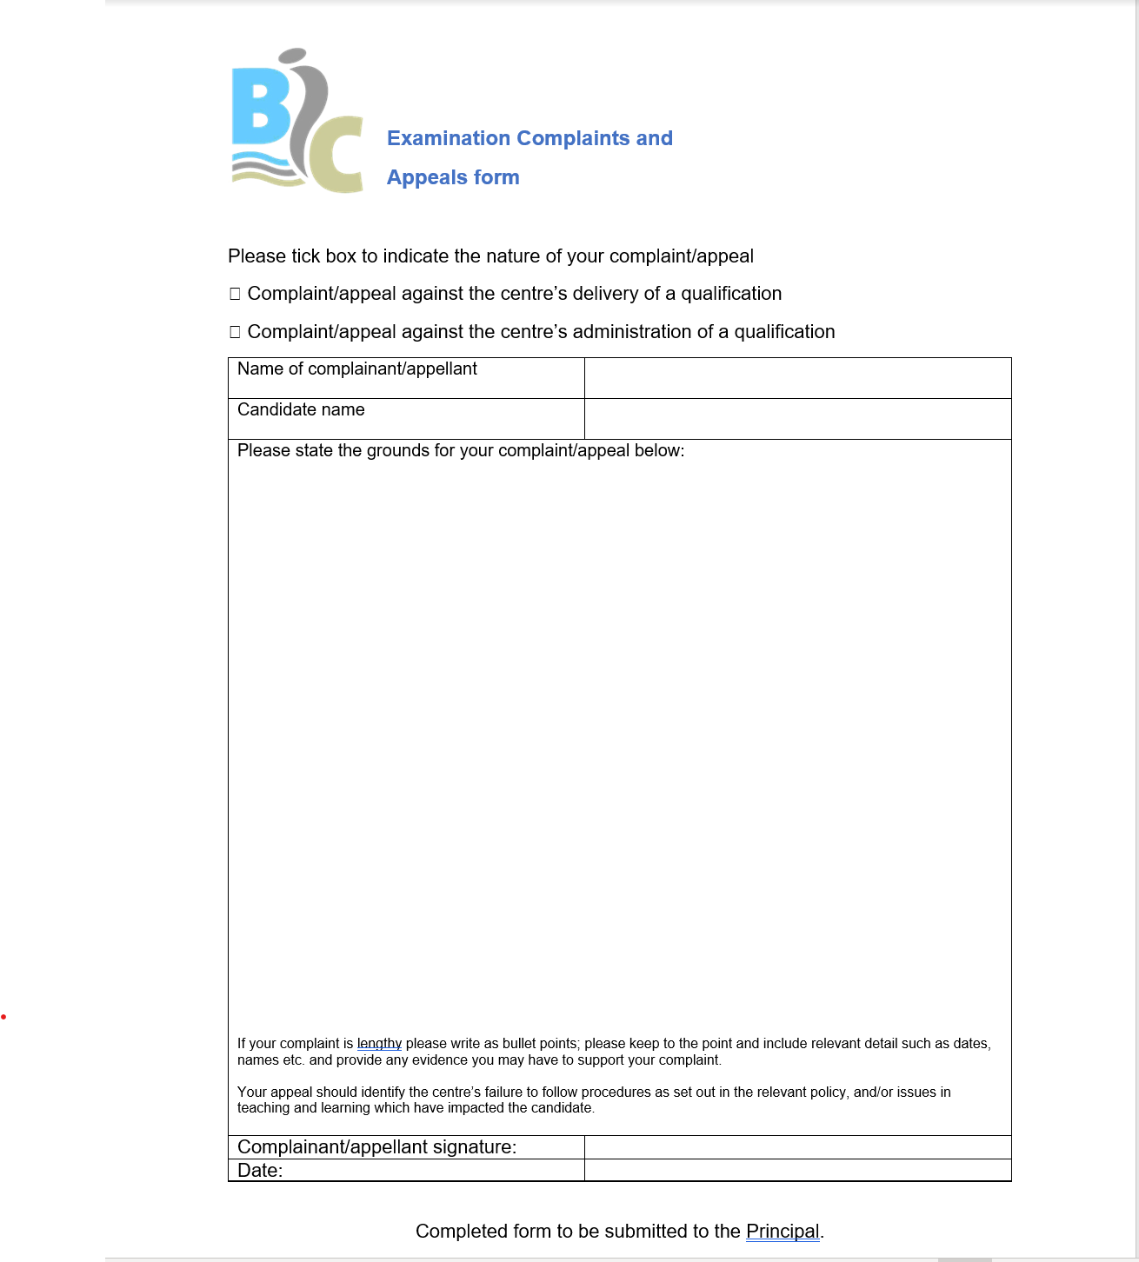


Slide 24


